Slide 1
Healthy Churches Honor each other
1 Timothy 5:17–6:2
Preached by Dr. Jim Harmeling at Crossroads International Church Singapore • cicfamily.com Uploaded by Dr. Rick Griffith • Singapore Bible College Thousands of files in 49 languages for free at BibleStudyDownloads.org

Slide 2
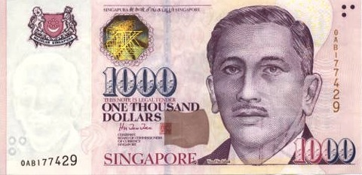
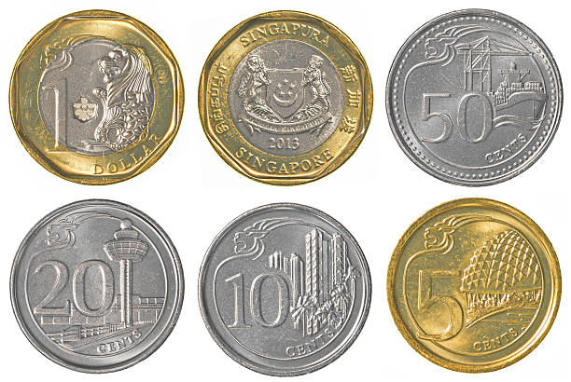
Which would you choose?

Slide 3
Healthy Church Life
Studies in 1 Timothy

Slide 4
Healthy Churches Honor each other
1 Timothy 5:1-6:2

Slide 5
Romans 12:10
“Love one another with brotherly affection.
Outdo one another in showing honor.”
1 Peter 2:17
“Honor everyone.
Love the brotherhood.
Fear God.
Honor the emperor.”

Slide 6
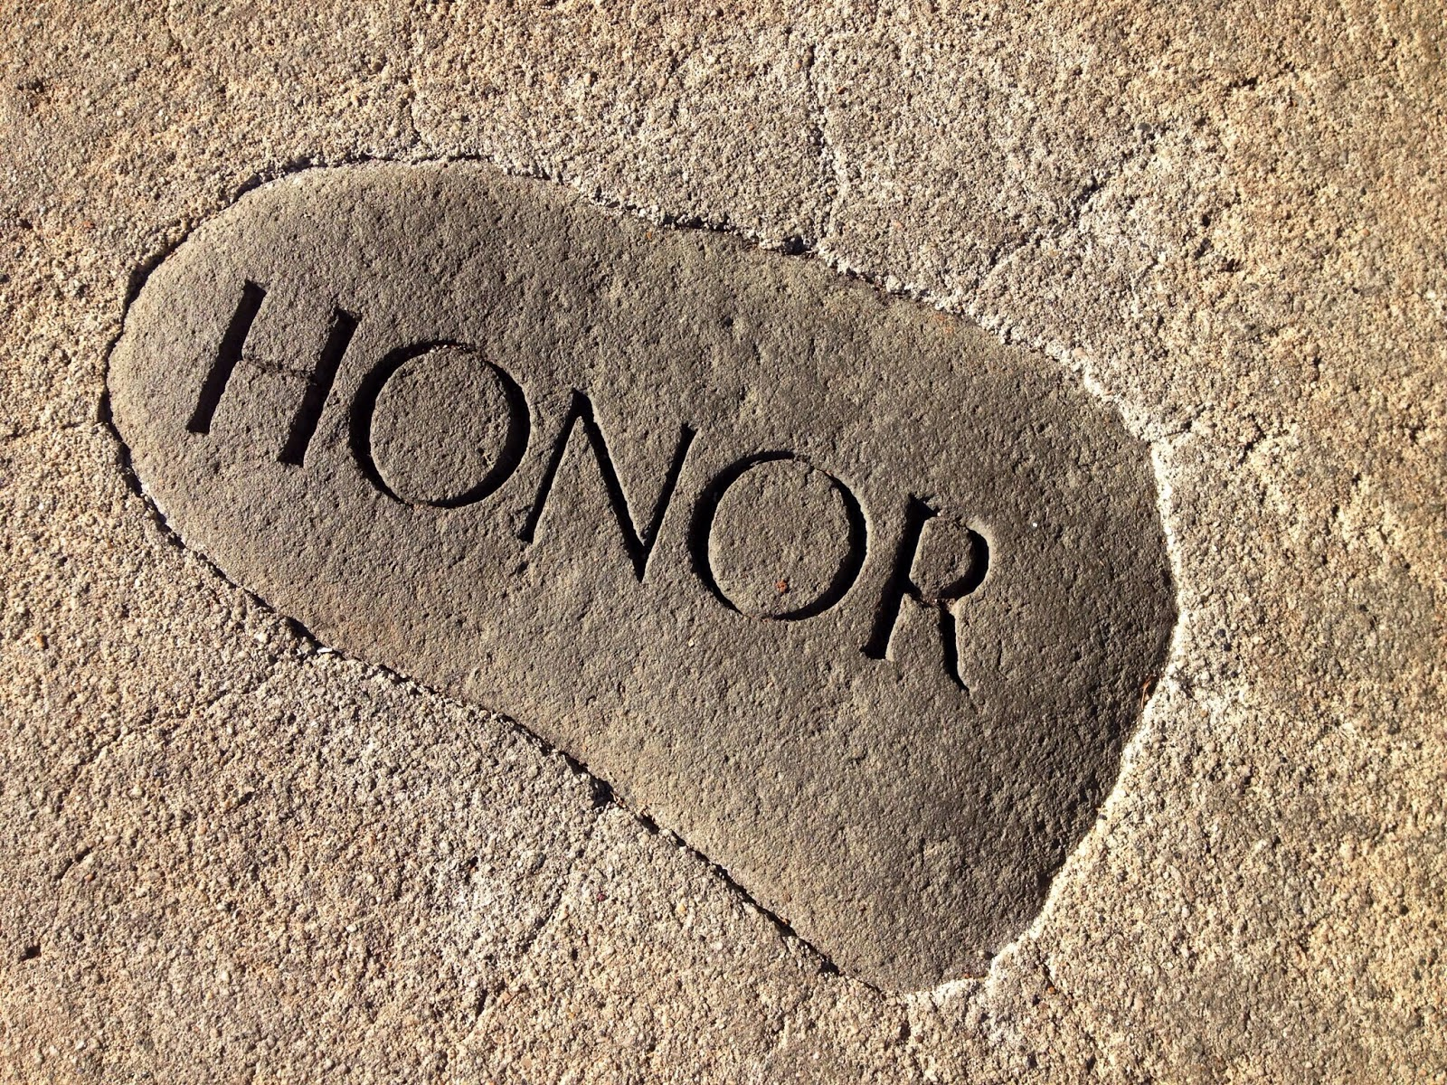
Healthy churches honor each other sensitively (5:1-2)
Healthy churches honor those who are vulnerable and in need (5:3-16)

Slide 7
How do I show honor using social media?

Slide 8
Ephesians 4:29
“Let no corrupting talk come out of your mouths, but only such as is good for building up, as fits the occasion, that it may give grace to those who hear.”

Slide 9
How do I respond to a post with honor?
Don’t be impulsive
Listen to what is said/written
Talk personally
Clarify
Affirm the good & confront the bad
Strengthen the relationship

Slide 10
How do I post with honor?

Slide 11
What?
Why?
Who?
How?
What?

Slide 12
Healthy churches honor each other sensitively (5:1-2)
Healthy churches honor those who are vulnerable and in need (5:3-16)
Healthy churches honor their leaders (5:17-25)
Honor those that lead well (vs. 17-19)
Deuteronomy 19:15
“A single witness shall not suffice against a person for any crime or for any wrong in connection with any offense that he has committed. Only on the evidence of two witnesses or of three witnesses shall a charge be established.”

Slide 13
Healthy churches honor each other sensitively (5:1-2)
Healthy churches honor those who are vulnerable and in need (5:3-16)
Healthy churches honor their leaders (5:17-25)
Honor those that lead well (vs. 17-19)
Confront those that do not lead well (vs. 20-25)

Slide 14
1 Samuel 26:11
“The Lord forbid that I should put out my hand against the Lord's anointed. But take now the spear that is at his head and the jar of water, and let us go.”

Slide 15
Healthy churches honor each other sensitively (5:1-2)
Healthy churches honor those who are vulnerable and in need (5:3-16)
Healthy churches honor their leaders (5:17-25)
Healthy churches honor their employers (6:1-2)
Honor is a testimony of the gospel (v. 1)
Honor is an act of love (v. 2)

Slide 17
NT Preaching • BibleStudyDownloads.org
Get this presentation for free!

